Slide 1

Renewable Energy Powered Weather Monitoring System Using IoT
Under the Guidance of-: Submitted By-:
Prof.Radheshyam Saha(Supervisor)
Mr. Krishna Dutt(Co-Supervisor)
Shresth Srivastava(2K19/EE/238)
Shivam Kaushik(2K19/EE/234)
Rahul(2K19/EE/197)

Slide 2
INDEX
Introduction
Objective
Hardware Details
Coding and Hardware Results
Conclusion
Future Scope
References

Slide 3
Introduction
Weather estimate, in reality continuous weather gauge is essential for our day by day life particularly in agribusiness. National weather data does not generally contain the precise information of each area, rather it contains the information of the closest climate station for a timeframe.
Weather is driven by air pressure (temperature and moisture) differences between one place and another. These pressure and temperature differences can occur due to the sun angle at any particular spot, which varies by latitude from the tropics. The atmosphere is a chaotic system, so small changes to one part of the system can grow to have large effects on the system as a whole.

Slide 4
Objective
The fundamental aim of this project is to develop a renewable energy source powered weather station which will help to monitor the weather parameters.
Such a project contains sensors for detecting temperature, humidity, raindrop, noise, CO2 gas concentration and barometric pressure etc. The information from the sensors are gathered by the Arduino. Arduino sends the sensor information to mobile applications through a serial terminal Bluetooth profile.
The parameters can also be monitored in real time through a mobile application. If any critical weather is detected then a warning indication and alert is provided to get protected from the severe weather condition.

Slide 5
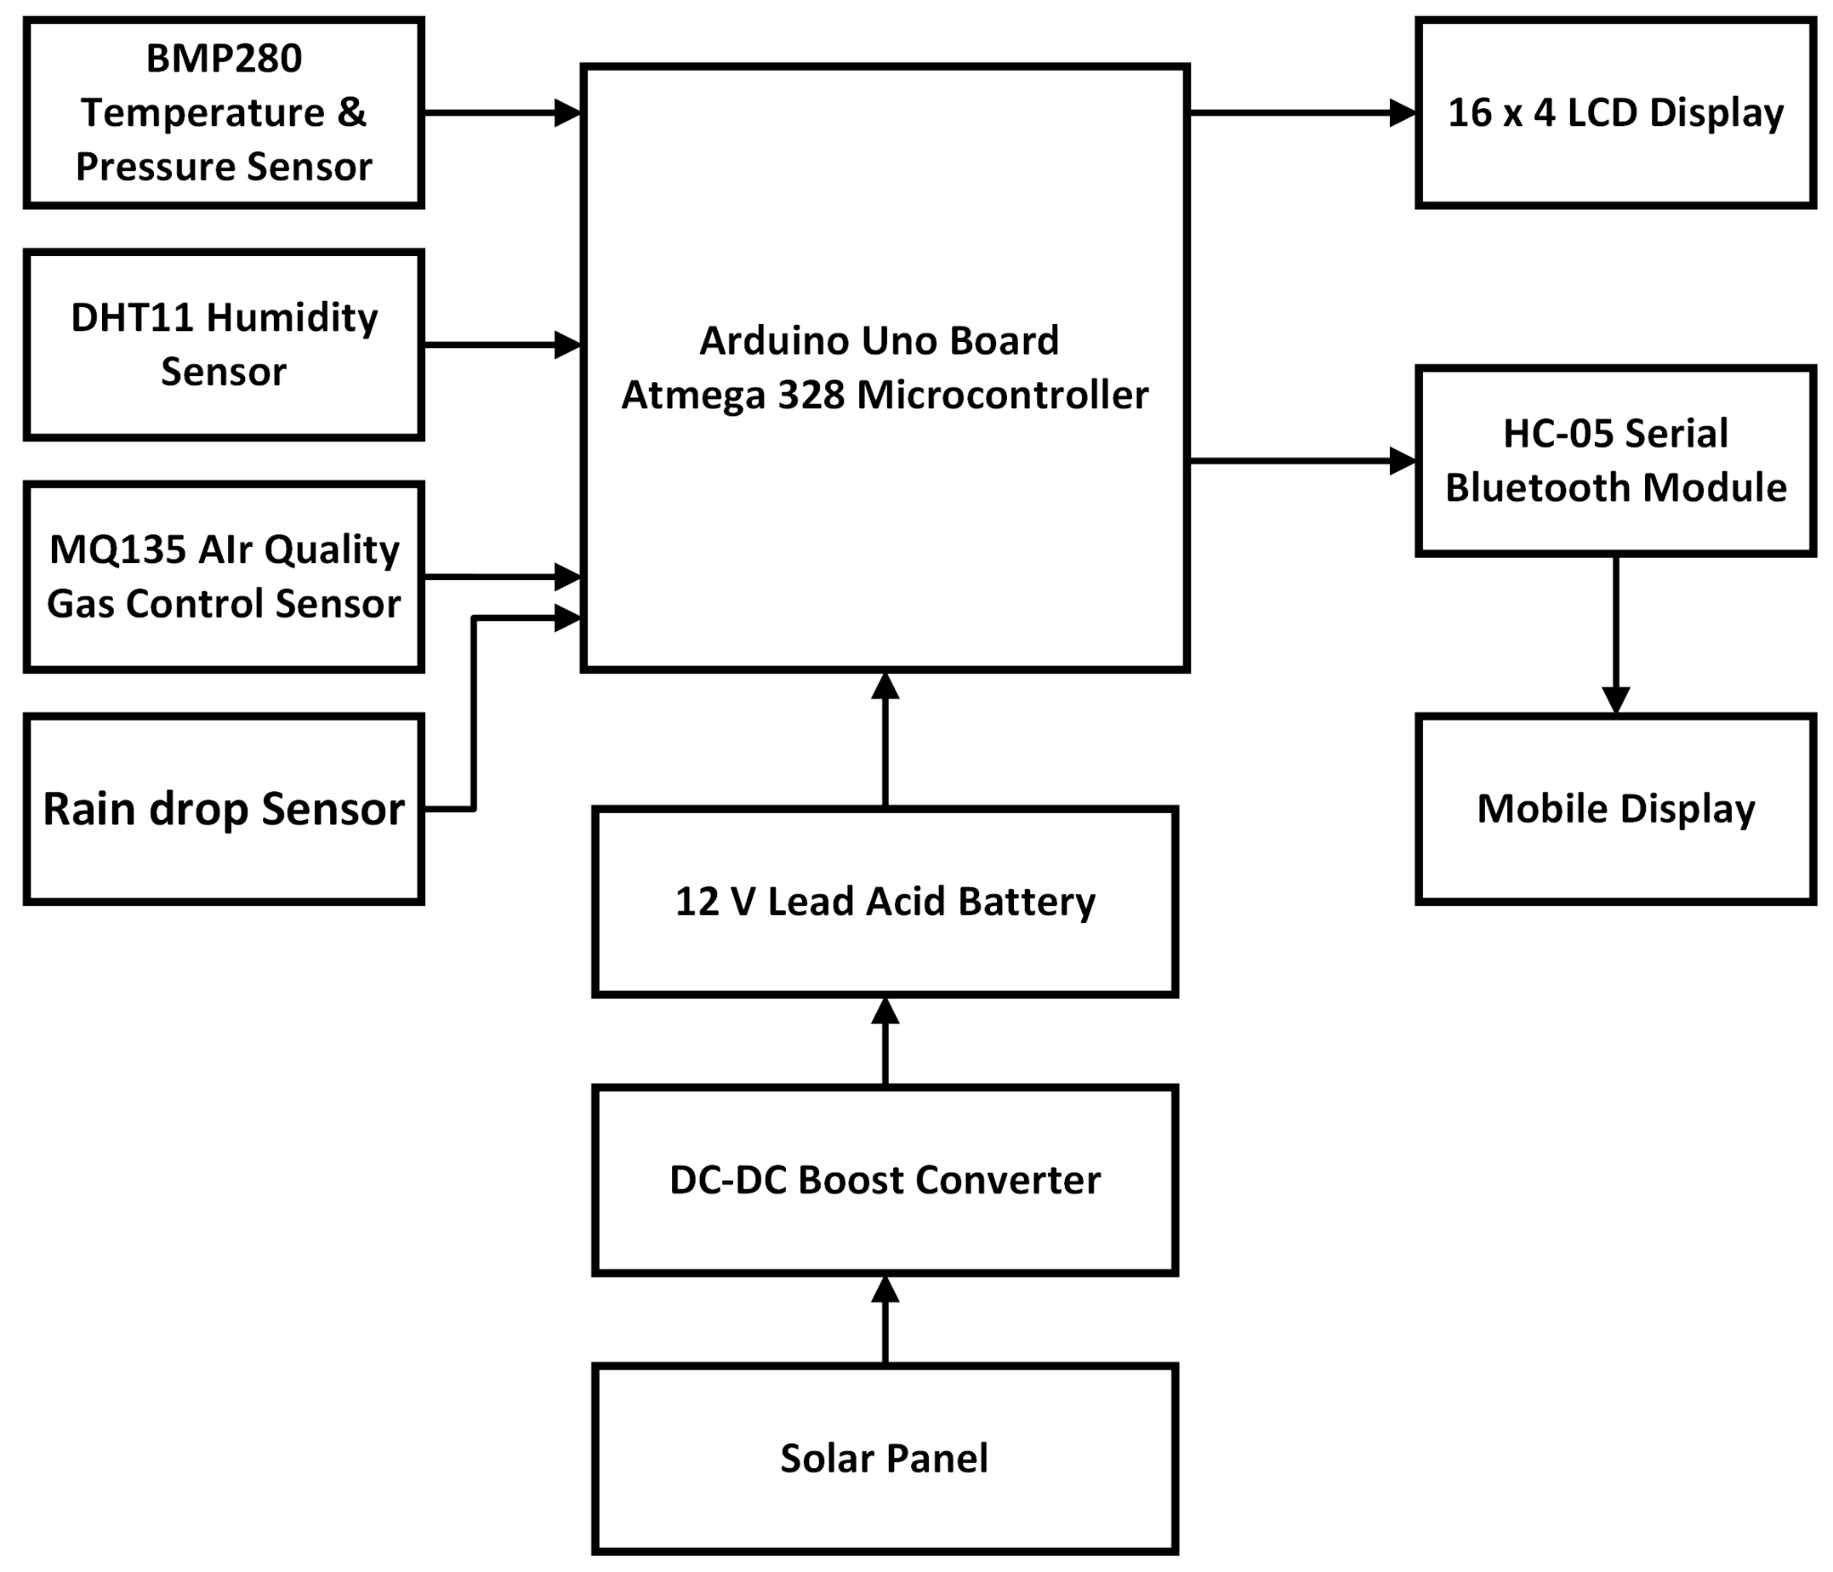
Block Diagram of Weather Monitoring System Using IoT

Slide 6
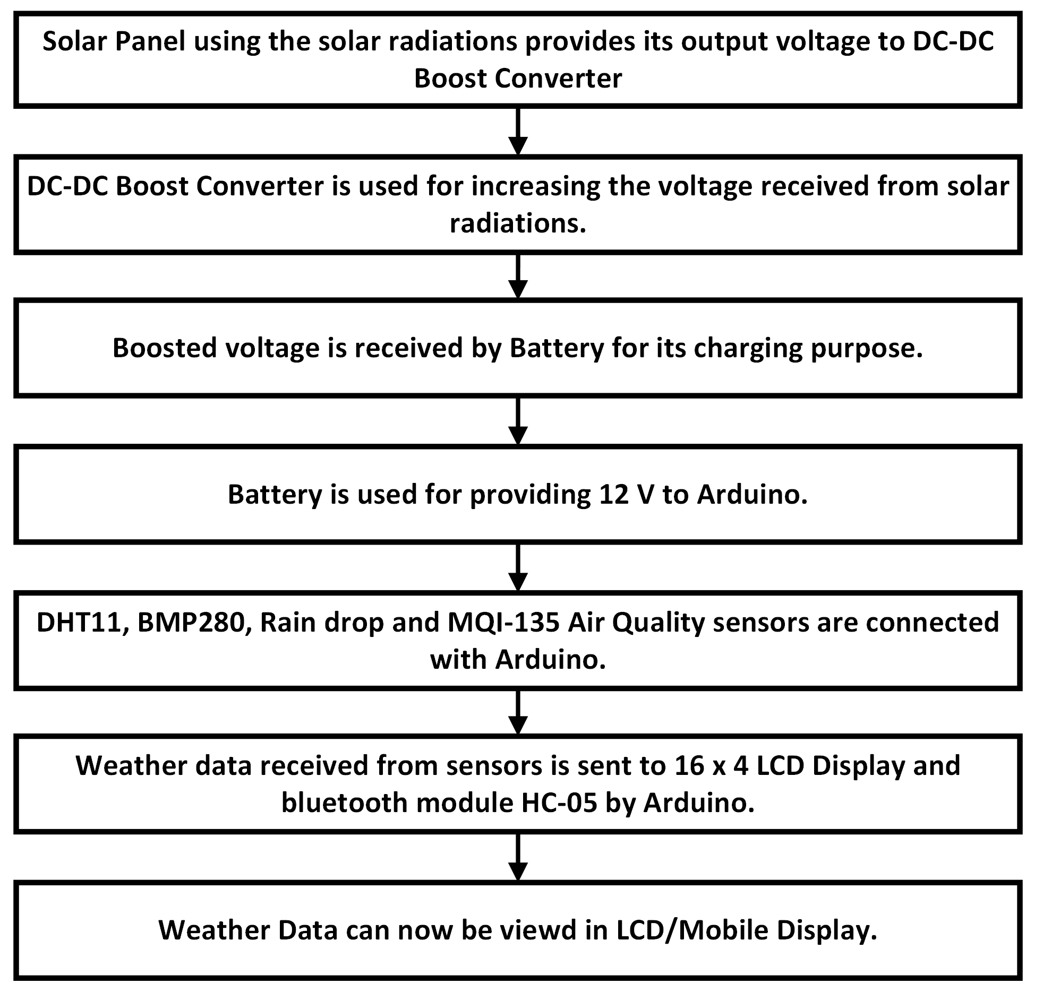
Working Principle of Weather Monitoring System

Slide 7
Components Used
DHT11 Humidity And Temperature Sensor
BMP280 Barometric Pressure and Altitude Sensor
Rain Drop Sensor
MQ135 Air Control Gas Sensor
LCD Display
HC-05 Serial Bluetooth Module
Arduino Uno
Battery
DC-DC Boost Converter
Solar Panel

Slide 8
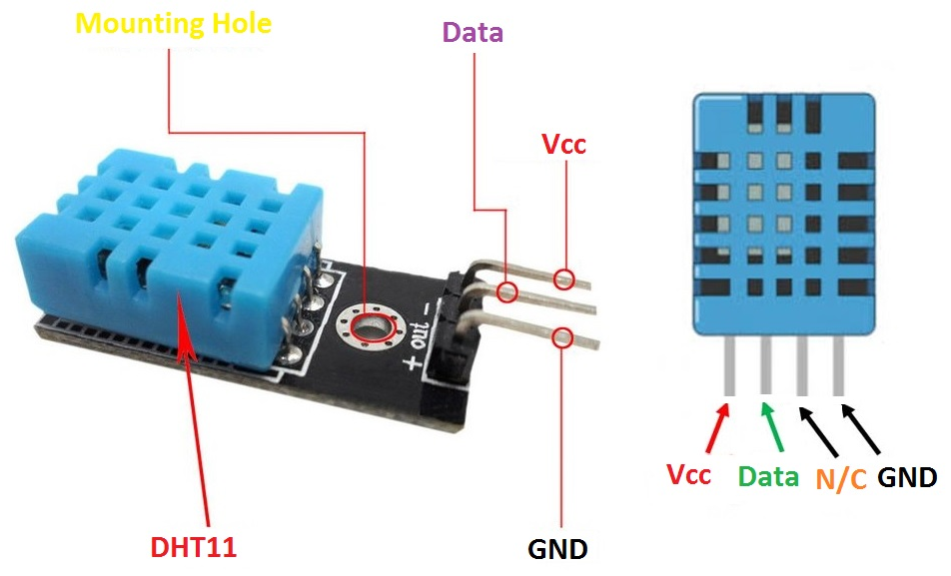
DHT11 Humidity And Temperature Sensor

Slide 9
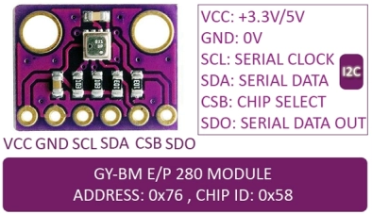
BMP280 Barometric Pressure And Altitude Sensor

Slide 10
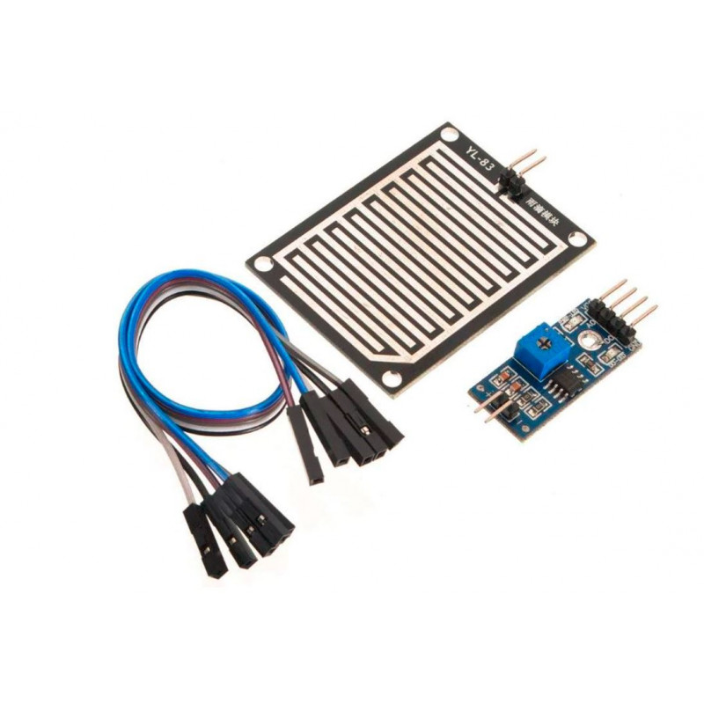
Rain Drop Sensor
Sensing pad
Rain Module
Connecting Wires

Slide 11
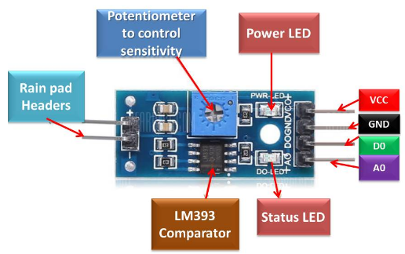
Rain Module

Slide 12
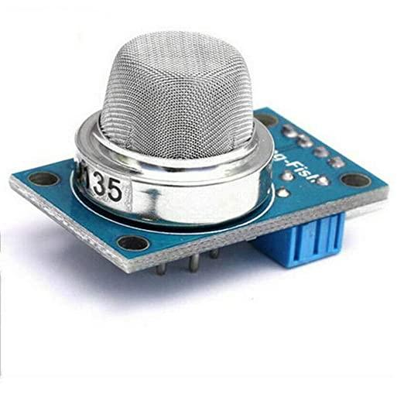
MQ135 Air Quality Gas Control Sensor

Slide 13
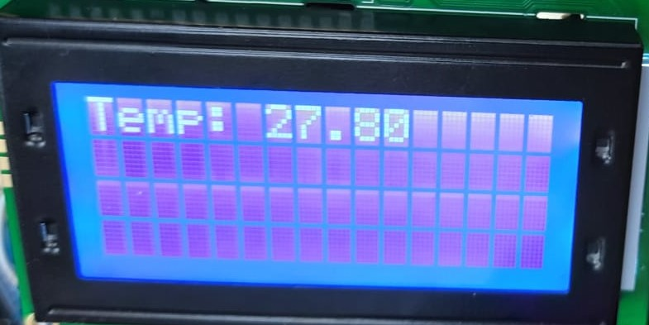
LCD Display

Slide 14
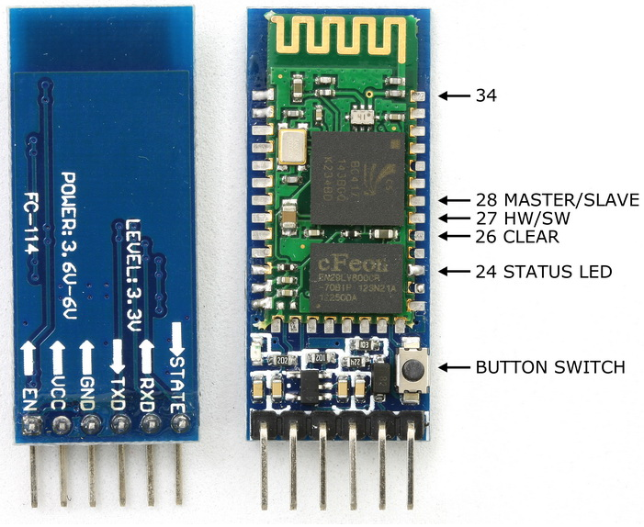
HC-05 Serial Bluetooth Module

Slide 15
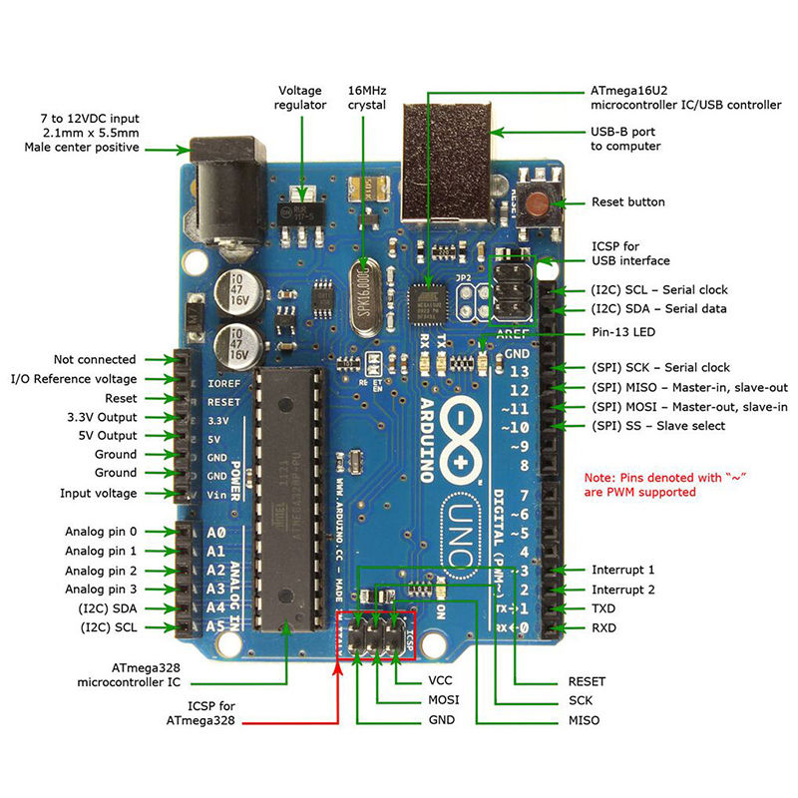
Arduino Uno

Slide 16

Battery
Brand | Amaron Quanta
Product Dimensions | 3.99 X 5.99 X 24.89 cm
Voltage | 12V
Charging Time | 4A/W
Battery Cell Composition | Lead Acid
Item Weight | 2.5 Kg
Rating | 12V/7Ah

Slide 17
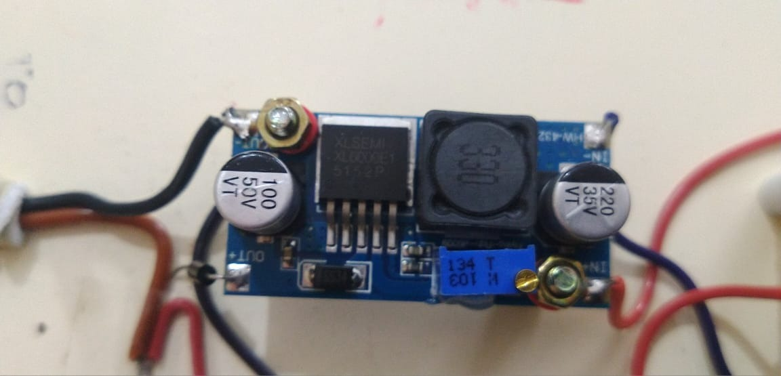
DC-DC Boost Converter
Output Range | 5V-35V
Input Current(max) | 4A
Conversion Efficiency | <94%
Switching Frequency | 400KHz

Slide 18
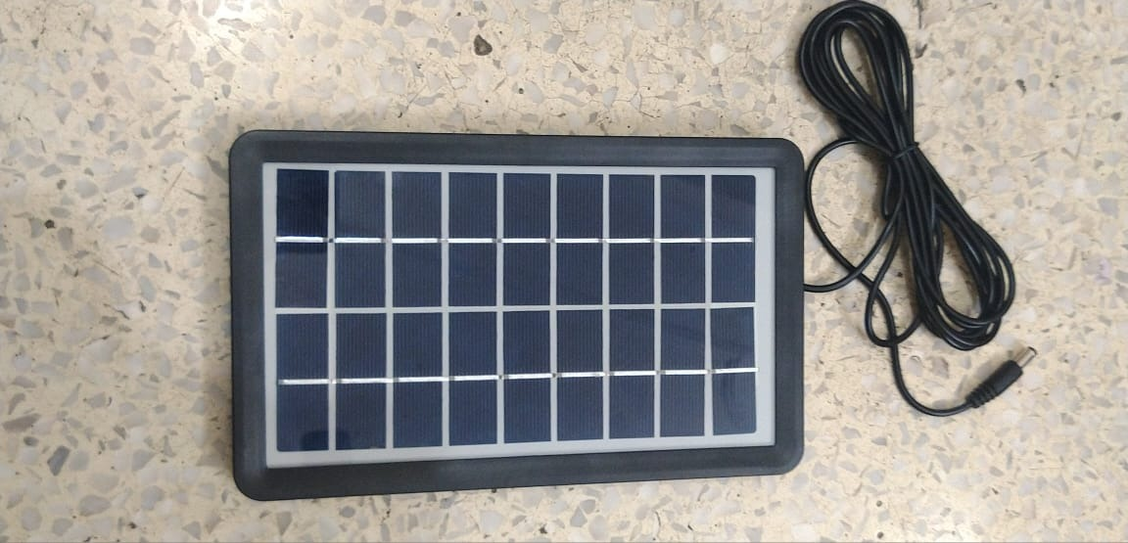
Solar Panel
Model | 9V 3W
Solar Cell | Polycrystalline silicon
Dimensions | 14 x 23 cm
Output Wire | 10FT
Application Range | Charge 3V-5V batteries
Optimum Operating Voltage | 9V
Optimum Operating Current | 600mA

Slide 19
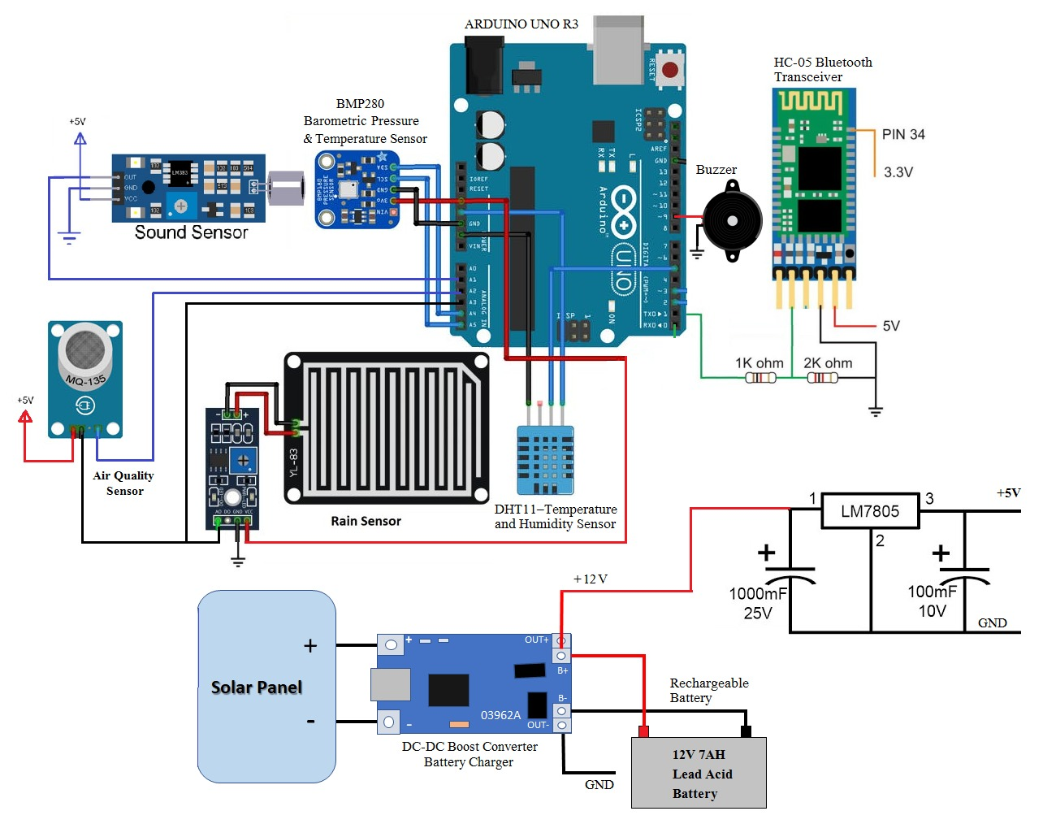
Circuit Diagram
9 V, 3 W
Circuit Diagram of Weather Monitoring System using IoT

Slide 20
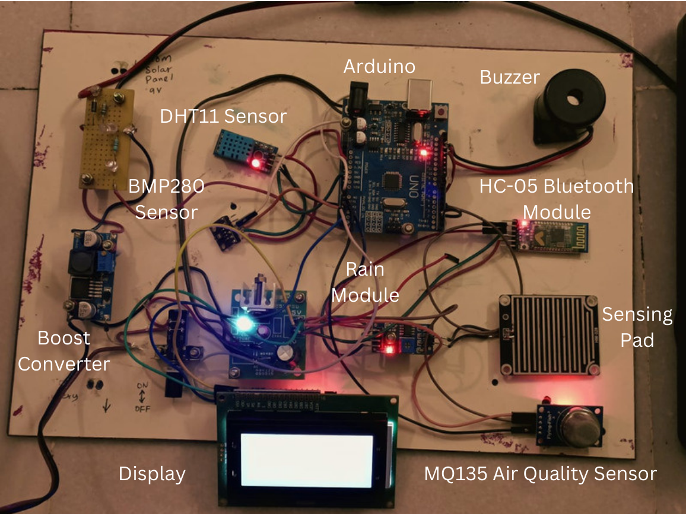
Top View of Hardware Model

Slide 21
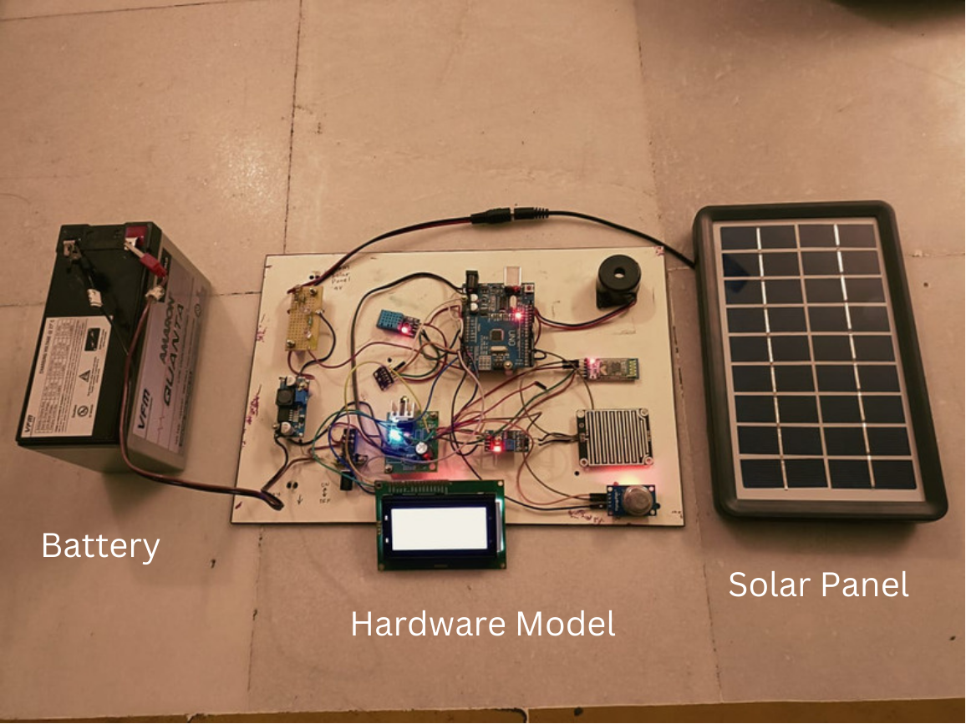
Front View of Hardware Model

Slide 22
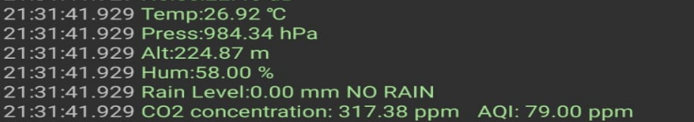
Output

Slide 23
Variation of Temperature
Date & Time | Actual Values | Expected Values | Error
22-03-2023 13:00 | 27.59℃ | 28℃ | 0.41℃
22-03-2023 14:00 | 28.31℃ | 29℃ | 0.69℃
22-03-2023 15:00 | 29.52℃ | 29℃ | 0.52℃
22-03-2023 16:00 | 28.57℃ | 28℃ | 0.57℃
22-03-2023 17:00 | 27.13℃ | 26℃ | 1.13℃
22-03-2023 18:00 | 24.46℃ | 24℃ | 0.46℃
22-03-2023 19:00 | 23.92℃ | 23℃ | 0.92℃
22-03-2023 20:00 | 23.37℃ | 23℃ | 0.37℃
22-03-2023 21:00 | 22.09℃ | 22℃ | 0.09℃
22-03-2023 22:00 | 21.76℃ | 22℃ | 0.24℃
22-03-2023 23:00 | 20.92℃ | 21℃ | 0.08℃
23-03-2023 00:00 | 19.67℃ | 20℃ | 0.03℃

Slide 24
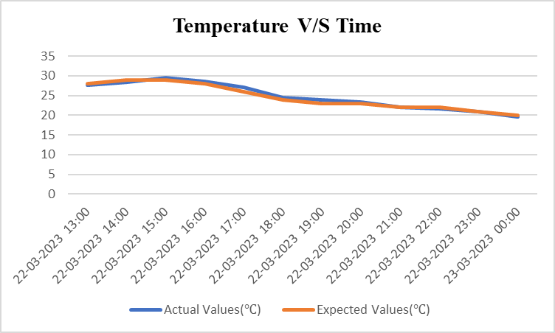
Temperature vs Time

Slide 25
Variation of Humidity
Time | Actual Values | Expected Values | Error
22-03-2023 13:00 | 39% | 43% | 4%
22-03-2023 14:00 | 36% | 40% | 4%
22-03-2023 15:00 | 38% | 41% | 3%
22-03-2023 16:00 | 41% | 45% | 4%
22-03-2023 17:00 | 46% | 48% | 2%
22-03-2023 18:00 | 50% | 51% | 1%
22-03-2023 19:00 | 52% | 54% | 2%
22-03-2023 20:00 | 56% | 59% | 3%
22-03-2023 21:00 | 58% | 61% | 3%
22-03-2023 22:00 | 60% | 64% | 4%
22-03-2023 23:00 | 63% | 65% | 2%
23-03-2023 00:00 | 66% | 67% | 1%

Slide 26
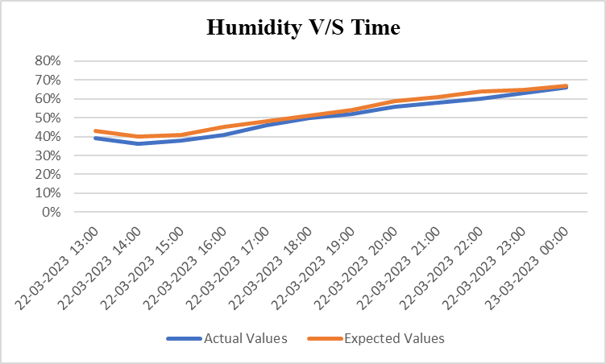
Humidity V/S Time

Slide 27
Variation of Altitude and Pressure
Altitude | Pressure
246.69 | 981.79
247.90 | 981.64
233.82 | 983.29
227.96 | 983.98
222.29 | 984.64
220.04 | 984.91
218.72 | 985.06
206.91 | 986.45
203.75 | 986.88

Slide 28
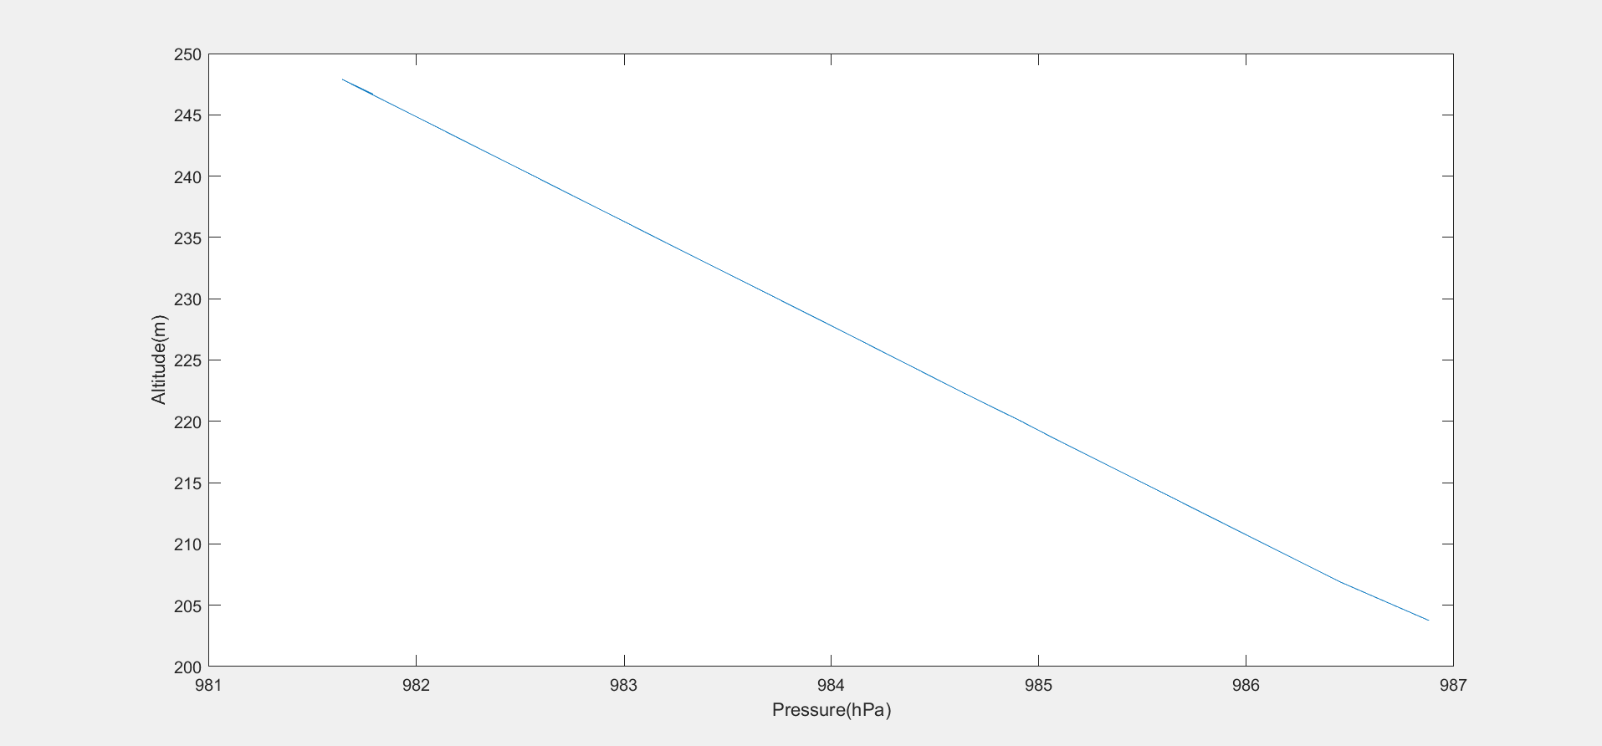
Altitude V/S Pressure

Slide 29
Conclusion
For temperature, the average inaccuracy was determined to be around 2%, while for humidity, it was estimated to be around 3.27%.
The scope of the weather station will give us the chance to distinguish a slight difference in climate inside a little space of region, which will make our climate anticipating framework more one of a kind and solid.
The proposed system has sensors for detecting Temperature, Humidity, Air Quality, Noise,Barometric pressure and Rain level The system mainly is used for monitoring the weather parameters in a place and the system is portable i.e. can be carried easily to any place due to its size.
The system developed is cost effective and all the parameters are uniquely identifiable through the embedded computing system. The system senses and communicates to the low energy Bluetooth wireless platform service and updates the weather data to a remote mentoring unit which is Android mobile app. The weather information can be accessed via Android app. It takes information about the surroundings environment through sensors and upload it directly to the mobile app, where it can be accessed anytime and logged.

Slide 30
Application of Weather Monitoring System
Agriculture Field Monitoring: It will provide a competent method for recording real time weather readings and help farmers whose livelihood depends on the weather in a country like India to produce better quality crops.
Packaging Industry: It can also be used in packaging industry where weather monitoring plays a crucial role. The sensors can be sensed in a room or an industry by using this system.
Construction Sites: The system is going to sense any targeted place/area.. By this way we get specific results regarding environmental factors which might be very crucial for construction sites.
Hill Stations: The weather changes very quickly in hilly areas. So, our system might be a very convenient system to keep track of the changing weather conditions.

Slide 31
Future Scope
There are certain range limits for each kind of sensor like in BMP280 accuracy is high only when temperature is above 0 degree celsius. We want to analyze our system at critical conditions. So that we can also come up with a solution in abnormal conditions.
Using the Thingspeak cloud and ESP8266 Module we will be able to see instant visualizations of data posted from our sensors. Also, we want to perform online analysis and data processing with MATLAB so that we can create automatic visualizations from live processed data.
Another future scope is that we want to convert the Weather monitoring system into weather forecasting system where we can predict the data of next day analyzing the previous data.

Slide 32
References
[1] Ravi Kishore Kodali and Snehashish Mandal “IoT Based Weather Station” International Conference on Control, Instrumentation, Communication and Computational Technologies (ICCICCT) 978-1-5090-5240-0/16/$31.00, IEEE, (2016) .
[2] Tanmay Parashar, Shobhit Gahlot, Akash Godbole, Y.B. Thakare “Weather Monitoring System Using Wi-Fi”, (IJSR) ISSN (Online): 2319-7064 Index Copernicus Value (2015): 78.96, 2015 .
[3] Kavya Ladi, A V S N Manoj, G V N Deepak, “IOT Based Weather Reporting System to Find Dynamic Climatic Parameters”, International Conference on Energy, Communication, Data Analytics and Soft Computing (ICECDS-2017).
[4] P. Susmitha, G. Sowmya Bala “Design and Implementation of Weather Monitoring and Controlling System”, International Journal of Computer Applications (0975 – 8887) Volume 97– No.3, (July 2014) .
[5] Ram, K. S. S., & Gupta, A. N. P. S. ,” IoT based Data Logger System for weather monitoring using Wireless sensor networks”, International Journal of Engineering Trends and Technology, 32(2), 71-75(2016).. [6] Govardhan, G., Hussain, S. J., & Jilani, S,” A smart gadget to analyse the weather changes using sense hat sensor and Internet of Things (IoT)”, Indian J. Sci. Technol, 9(35) (2016)

Slide 33
References - Continued
[7] Chandana, L. S., & Sekhar, A. R.,” Weather monitoring using wireless sensor networks based on IoT”, Int. J. Sci. Res. Sci. Technol, 4, 525-531,(2018).
[8] Nageswararao, J., & Murthy, G. K. (2017). Wireless Weather Monitor Using Internet of Things. i-Manager's Journal on Embedded Systems, 6(1), 30. [4]Chapman, L., & Bell, S. J. (2018). High-resolution monitoring of weather impacts on infrastructure networks using the Internet of Things. Bulletin of the American Meteorological Society, 99(6), 1147-1154.
[9] Montgomery. K, Chiang. K, “A New Paradigm for Integrated Environmental Monitoring”, ACM International Conference Proceeding Series, 2010.
[10] Mendelsohn, Robert, and Ariel Dinar. "Climate change, agriculture, and developing countries: does adaptation matter?." The World Bank Research Observer 14, no. 2: 277-293,(1999).
[11] Kurschl. W, Beer W, “Combining cloud computing and wireless sensor networks”, International Conference on Information Integration and Web-based Applications and Services, pp.512-518,( 2009).
[12] Ravi Kishore Kodali and Archana Sahu “An IoT based Weather Information Prototype Using WeMos” 2016 2nd International Conference on Contemporary Computing and Informatics (ic3i), 978-1-5090-5256-1/16/$31.00, IEEE, (2016)
[13] Zhengtong. Y, Wenfeng. Z, “The research of environmental pollution examination system based on Cloud Computing”, International Conference on Communication Software and Networks, pp.514-516, (2011).
[14] Wei. Q, Jin. N, Lou X, Ma. R, Xu. J, “Software design for water environment remote monitoring system based on mobile devices”, Applied Mechanics and Materials, pp. 2027-2032, (2011).

